Slide 1
Spotlight Talk : Kinodynamic Comfort Trajectory Planning for Car-like Robots
Heechan Shin, Donghyuk Kim and Sung-Eui Yoon

Slide 2
Motivation
When robots transport objects or passengers, translational force is applied.
In that situation, the objects may be disarranged or the passengers feel discomfort. To avoid these cases, comfort trajectory is preferred.

Slide 3
Main contributions
We define a new definition of comfort, measured by sum of translational forces, i.e., impulse.
We propose a new approach of measuring an obstacle cost for comfort trajectory planning.

Slide 4
Problem Definition
Trajectory planning w.r.t. ‘comfort’ factor
What is comfort?
Qualitative definition of Comfort :
“How low forces deforming states of an object carried by a robot are.”
F
Impulse
Quantitative definition of Comfort :
Propose to use Impulse during the travel
t

Slide 5
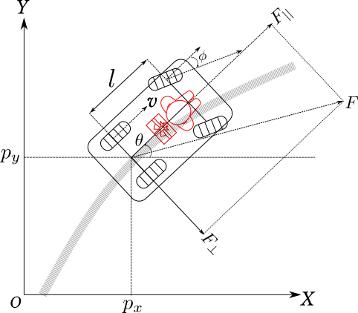
Formulation of Discomfort
$F_{⊥}$: lateral force
$a$ : acceleration
$$Discomfort=\frac{1}{m^{2}}{|\left|F\right||}^{2}=\frac{1}{m^{2}}{||F_{||}+F_{⊥}||}^{2}=a^{2}+κ^{2}v^{4}$$
$v$ : velocity
$F_{||}$: longitudinal force
$κ$ : curvature
$m$ : mass of target object

Slide 6
Transcript to Non-Linear Programming
$t$: travel time
$𝒪$: obstacle cost
$\min{ t+Σ\left(𝓒+𝓞\right)}$
$$subject to \\ Discomfort<𝒞_{max} \\ System dynamics \\ Other constraints$$
$𝒞$: discomfort cost
Transcription
[Trajectory optimization problem]
[Non-linear programming]
Convert a continuous trajectory optimization problem to a discrete NLP problem.
By doing so, we can efficiently plan the trajectory using off-the-shelf NLP solver.

Slide 7
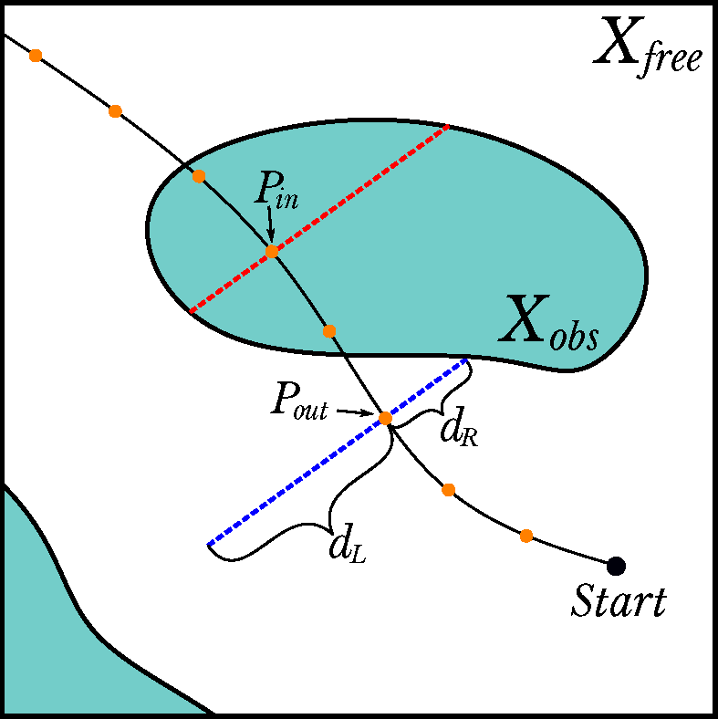
Bidirectional Obstacle Detection (BOD)
Concept of BOD
Global environment
Detected obstacles (red lines)
Propose a new measure for obstacle cost, named BOD, to push the trajectory perpendicularly.
Minimizes changing dynamic properties (e.g., velocity) of the trajectory, which may increase discomfort.
Improve comfort while optimizing the trajectory

Slide 8
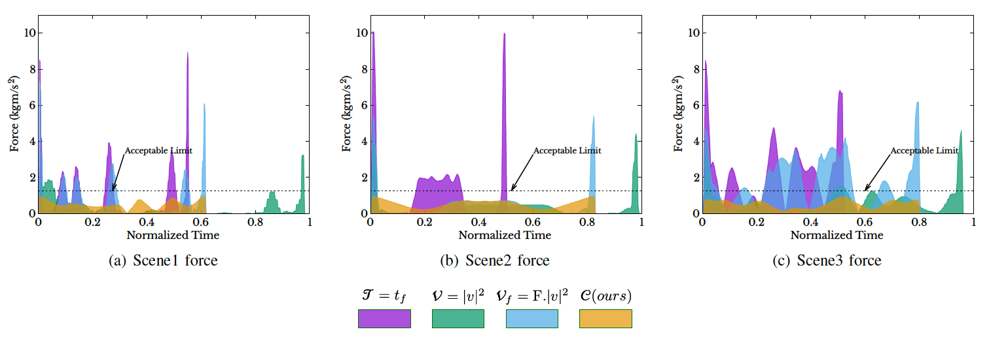
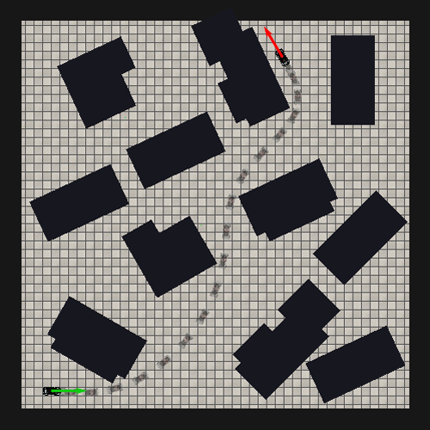
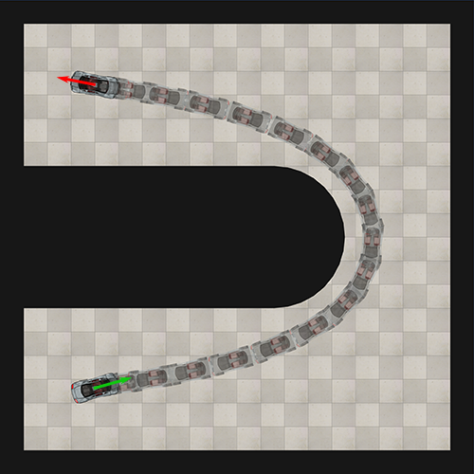
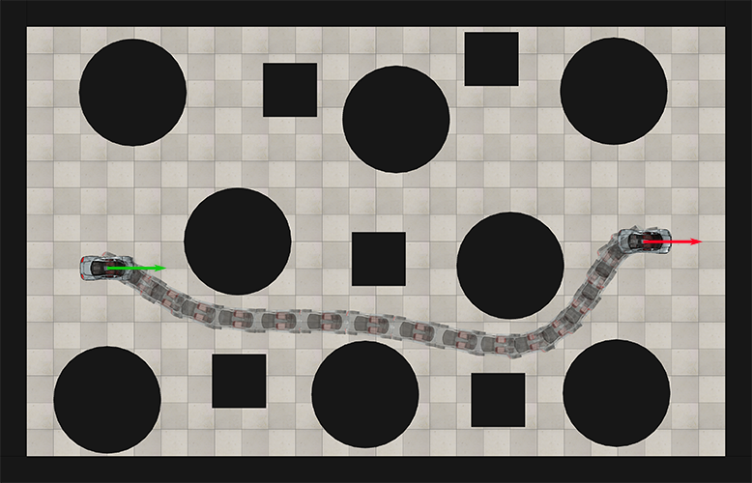
Experimental Result
메세지적기
Min. time
Min. $v^{2}$
Min. $v^{2}$ with fixed time
Ours
Only our method satisfies the acceptable max force constraint.
Our method (orange) gets lower force than other methods mostly during the travel, and shows reasonably less travel time.

Slide 10
THANK YOU

Slide 11
Heechan Shin, Donghyuk Kim, Sung-eui Yoon
Korea Advanced Institute of Science and Technology, South Korea
Main contribution
We define a new definition of comfort and its counterpart, discomfort, which is measured by sum of translational forces, i.e., impulse.
We propose a new approach of measuring obstacle cost which targeting to support comfort trajectory planning.
Methodology
Transcript trajectory optimization problem to non-linear programming by using direct collocation method.
Optimize the NLP according to comfort and obstacle objectives using NLP solver
Comfort objective is calculated according to its definition
Obstacle objective is calculated by using BOD
Problem definition
Transcription
Bidirectional Obstacle Detection
Planning a ‘comfort’ trajectory
What is Comfort?
Qualitative speaking “How low forces deforming states of an object carried by a robot are”
Quantitative speaking Impulse during travel $Σ_{t=0}^{τ}F$
We propose a novel approach to measure obstacle cost, named Bidirectional Obstacle Detection (BOD), which guides the NLP solver to push the trajectory perpendicularly.
This method minimizes an effect of changing dynamic properties (e.g., velocity or acceleration) of the trajectory, which may increase discomfort.
$$ξ=\{t_{f},x_{0}⋯x_{N},⋯\}$$
[Trajectory]
[Trajectory vector]
Convert a continuous trajectory optimization problem to a discrete NLP problem.
Formulation of discomfort
$$Discomfort=\frac{1}{m^{2}}{|\left|F\right||}^{2}=\frac{1}{m^{2}}{||F_{||}+F_{⊥}||}^{2}=a^{2}+κ^{2}v^{4}$$
Experiment Results
Our method (orange) gets lower force than forces of other methods during the travel.
Although the result of our method gets a greater impulse than the others, our method shows reasonably less travel time.
Only our method satisfies the acceptable max force constraint.
$F_{||}$: longitudinal force
$v$ : velocity
$F_{⊥}$: lateral force
$κ$ : curvature
$a$ : acceleration
$m$ : mass of target object

